Slide 1
Assignment Model

Slide 2
Assignment Problems
By Hungarian Method
By Branch and Bound Method /Technique (Little’s method) (Travelling Salesman Problem)
Basic requirement of Hungarian method
Problem must be of Minimization. If the problem is of Maximization type convert it to minimization type before solving by Hungarian method.
Problem must be of one to one basis of assignment i.e it must be of square matrix. If problem is of unbalanced assignment type introduce dummy row or dummy column as per the requirement.

Slide 3
Steps in Assignment Model
Step 1: Formulation of Problem statement
Step 2: Row Operation
Step 3 Column Operation
Step 4 Row Assignment
Step 5 Column Assignment
Step 6 Reduce the matrix
Cancelled once- As it is
Cancelled Twice- Add the minimum element
Not cancelled – Subtract minimum elelement
Step 7 Repeat step 4 to 6.

Slide 4
The Assignment Problem
In many business situations, management needs to assign - personnel to jobs, - jobs to machines, - machines to job locations, or - salespersons to territories.
Consider the situation of assigning n jobs to n machines.
When a job i (=1,2,....,n) is assigned to machine j (=1,2, .....n) that incurs a cost Cij.
The objective is to assign the jobs to machines at the least possible total cost.

Slide 5
The Assignment Problem
This situation is a special case of the Transportation Model And it is known as the assignment problem.
Here, jobs represent “sources” and machines represent “destinations.”
The supply available at each source is 1 unit And demand at each destination is 1 unit.

Slide 6
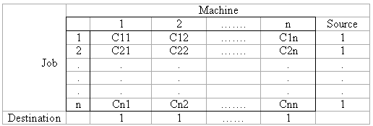
The Assignment Problem
The Assignment Problem
The assignment model can be expressed mathematically as follows:
Xij= 0, if the job j is not assigned to machine i
1, if the job j is assigned to machine i

Slide 7
Assignment Problems
Example: Machineco has four jobs to be completed. Each machine must be assigned to complete one job. The time required to setup each machine for completingeach job is shown in the table below. Machinco wants to minimize the total setup time needed to complete the four jobs.

Slide 8
Setup times
(Also called the cost matrix)
 | Time (Hours)
 | Job1 | Job2 | Job3 | Job4
Machine 1 | 14 | 5 | 8 | 7
Machine 2 | 2 | 12 | 6 | 5
Machine 3 | 7 | 8 | 3 | 9
Machine 4 | 2 | 4 | 6 | 10

Slide 9
The Model
According to the setup table Machinco’s problem can be formulated as follows (for i,j=1,2,3,4):

Slide 10
For the model on the previous page note that:
X_{ij}=1 if machine i is assigned to meet the demands of job j
X_{ij}=0 if machine i is assigned to meet the demands of job j
In general an assignment problem is balanced transportation problem in which all supplies and demands are equal to 1.

Slide 11
Assignment Problem
A bank officer has four subordinates and four task to be done. Subordinates differ in their efficiency, the task also differ in their intrinsic difficulty. His estimates of the time, each man/woman would take to perform each task is given in effectiveness matrix below. How should the task be allocated, one to one man so as to minimize the total man hours.
 | Time (Hours)
 | Task1 | Task2 | Task3 | Task4
Subordinate 1 | 18 | 26 | 17 | 11
Subordinate 2 | 13 | 28 | 14 | 26
Subordinate 3 | 38 | 19 | 18 | 15
Subordinate 4 | 19 | 26 | 24 | 10

Slide 12
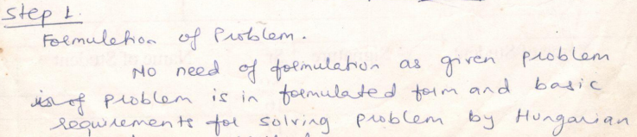


Slide 13
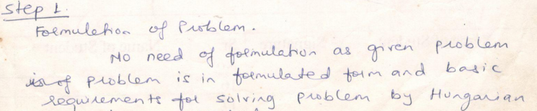
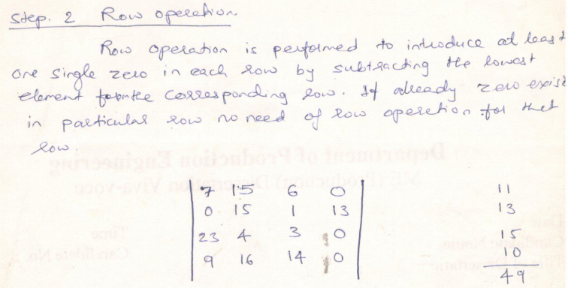

Slide 14
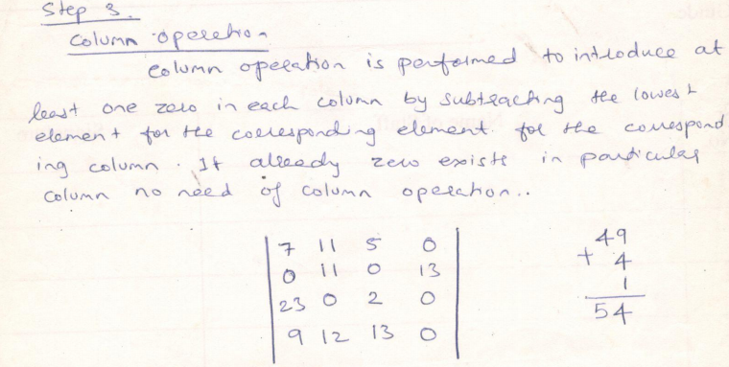

Slide 15
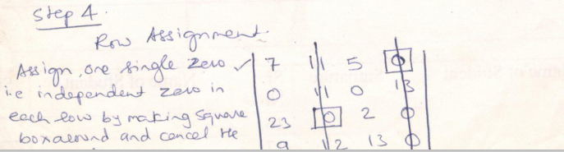
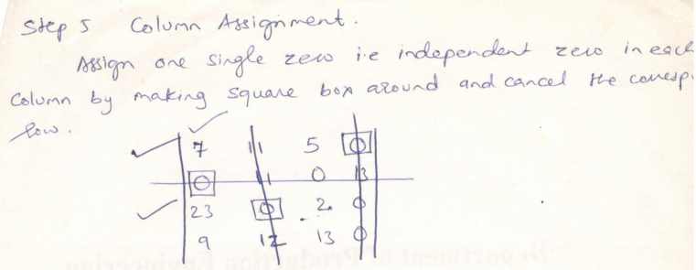

Slide 16
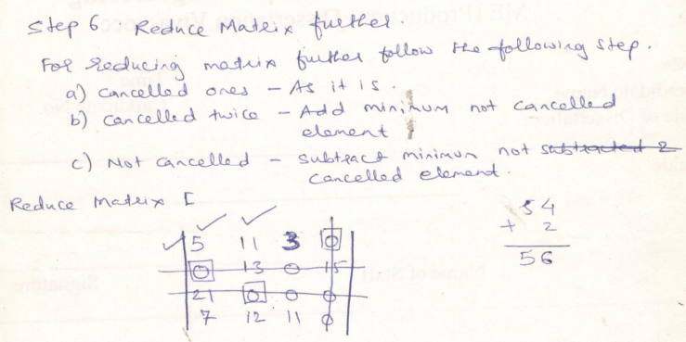

Slide 17
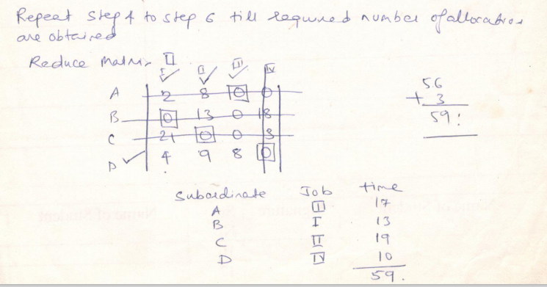

Slide 18
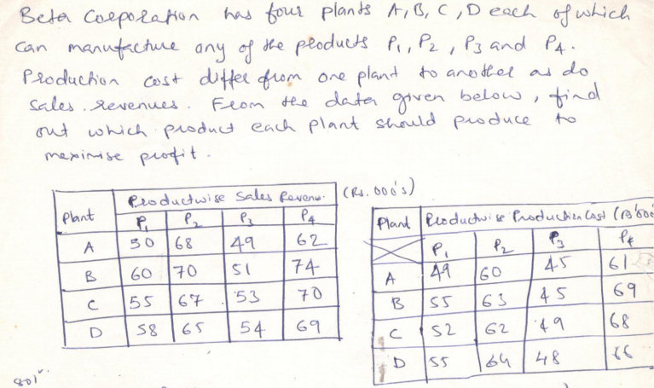

Slide 19
